Slide 1


Slide 2



MED4LIFE IS A MEDICAL APPLICATION
We put patients first.
The future of healthcare.
Making it more equal.
More accessible.
Easier for everyone.

Slide 3

01
Theme chosen
Plan
02
Problematic
03
Our Goal
Topics for discussion
04
Our Application
05
About us

Slide 4

Part 01
Theme Chosen

Slide 5
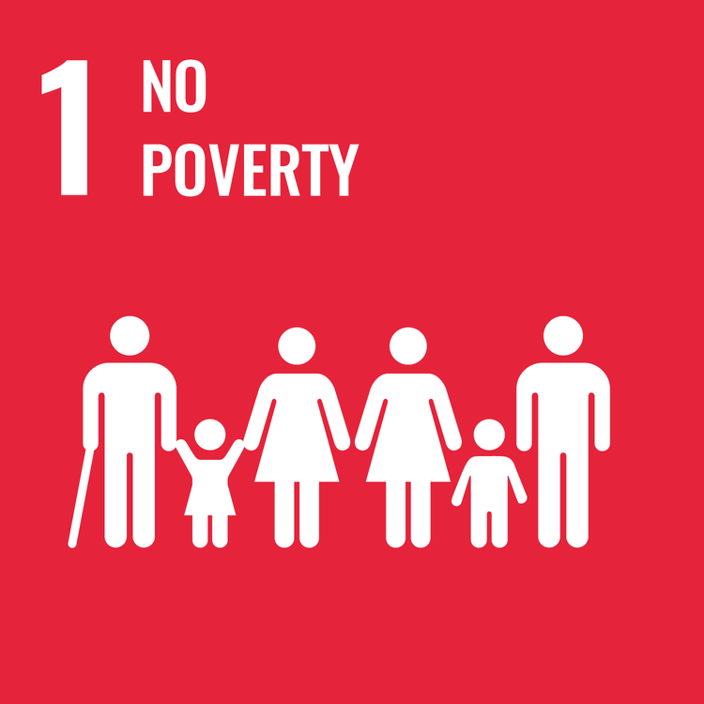

Donation
Health care

Slide 6
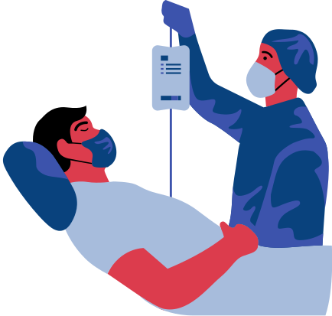
Part 02
Problematic

Slide 7
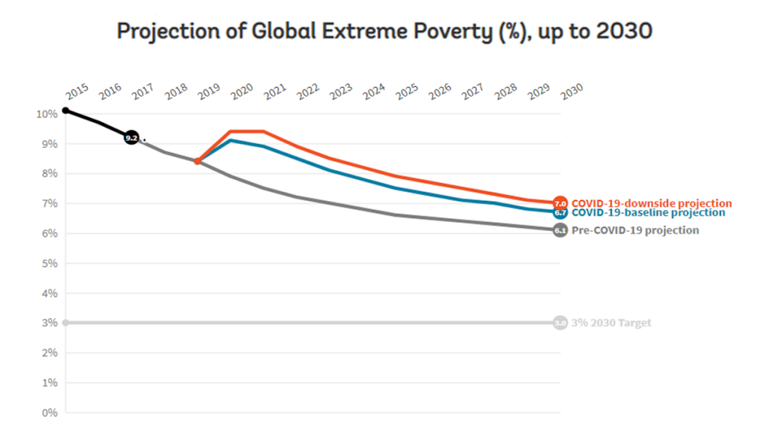
No poverty
Health & will being
Health situation in the world :
FIGHTING COVID-19
LEAVING NO ONE BEHIND
NEW PARTNERSHIPS FOR HEALTH

Slide 8

Part 03
Our Goal

Slide 9


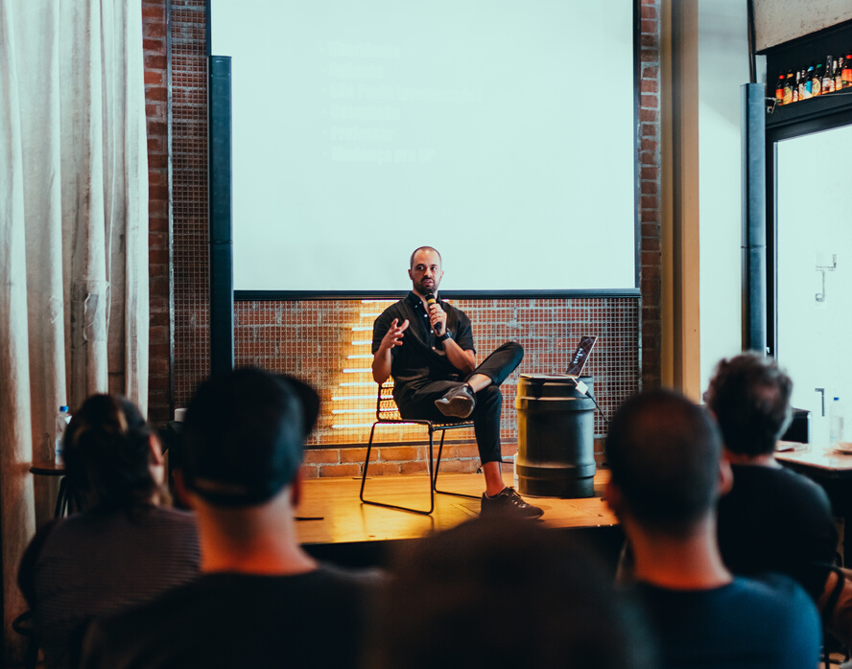
1. Facilitate the consultation with doctors.
2. Offer advices concerning health & get answers for any problem.
3. Donate to poor people.

Slide 10

Part 04
Our Application

Slide 11
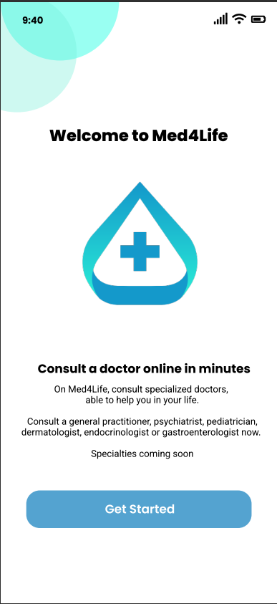
the welcome page

Slide 12
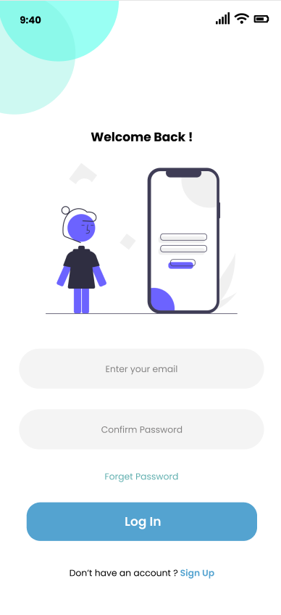
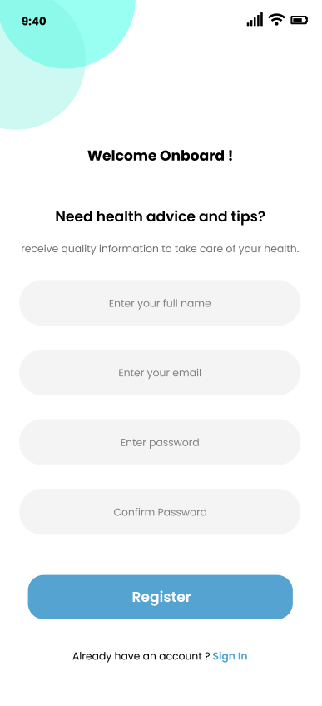
Sign In
Sign up

Slide 13
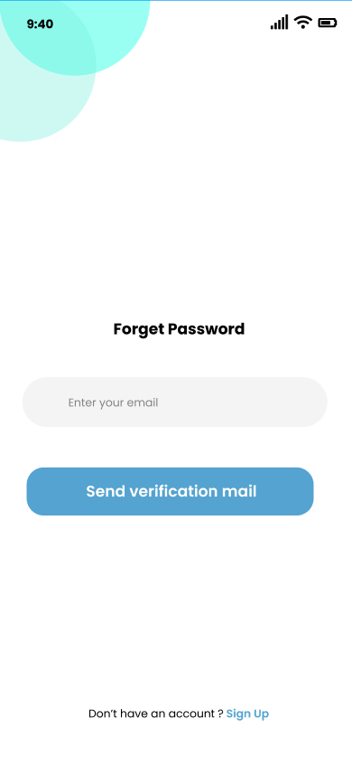
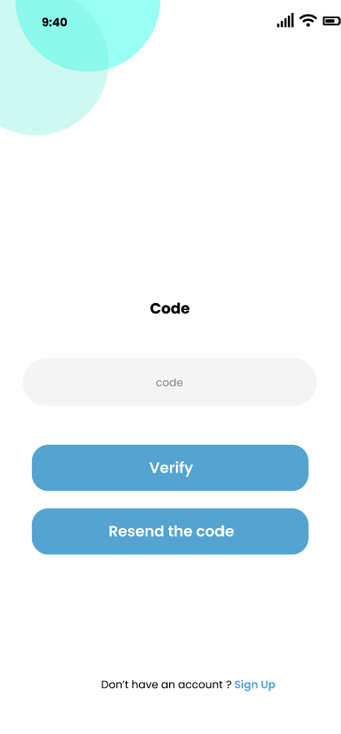
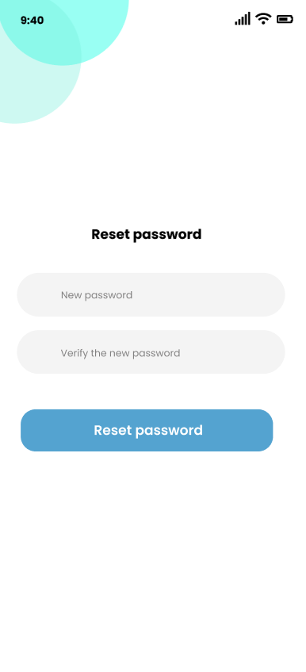
Forget password
Code Verification
Reset password

Slide 14
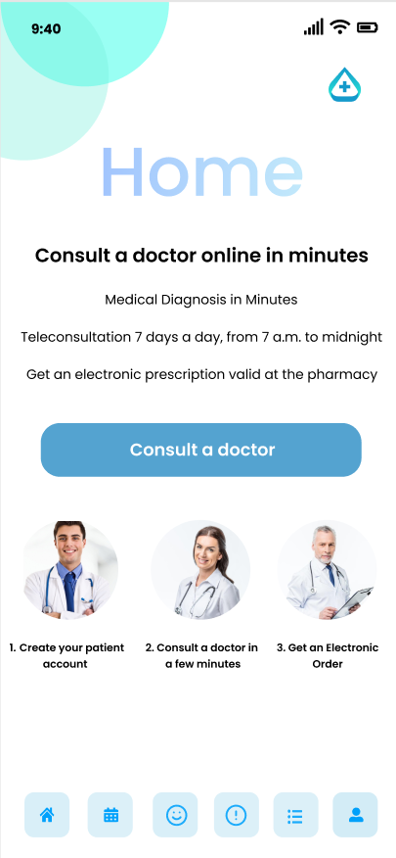
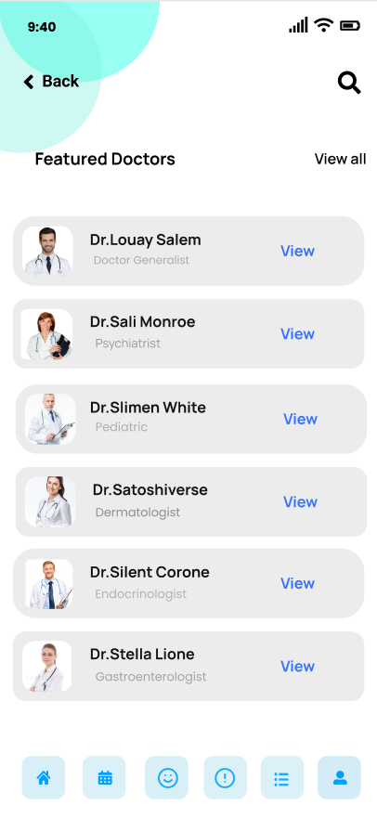
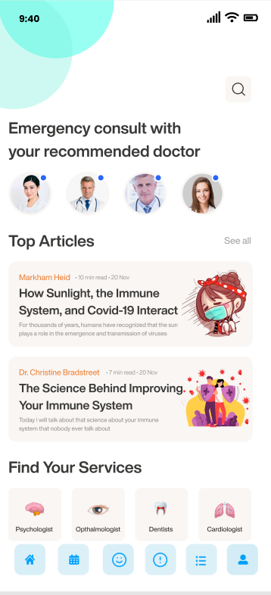
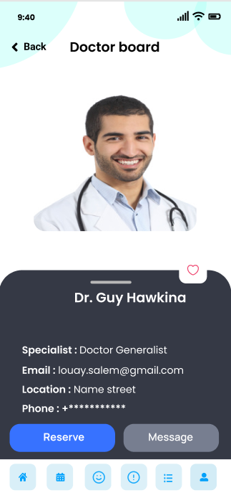
Home interface
Search

Slide 15



Our actors
Administrator
the responsable for the application (us)
The patient (user)
The doctor (user)

Slide 16
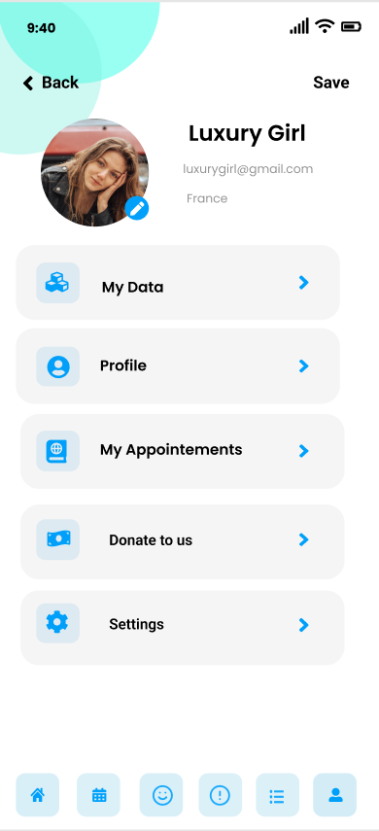
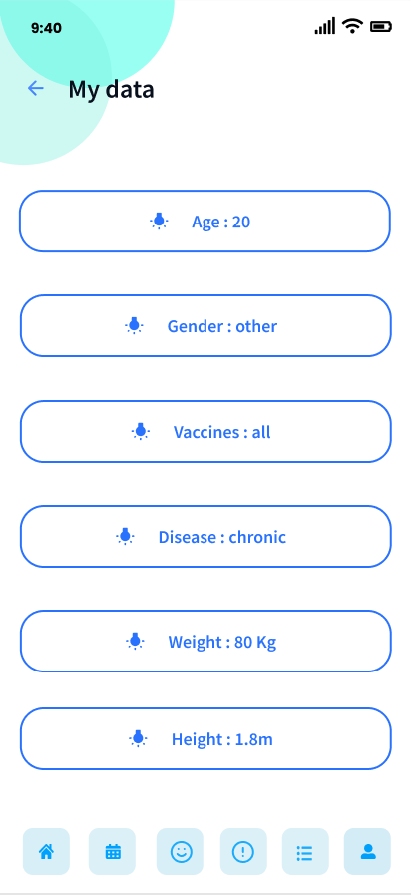
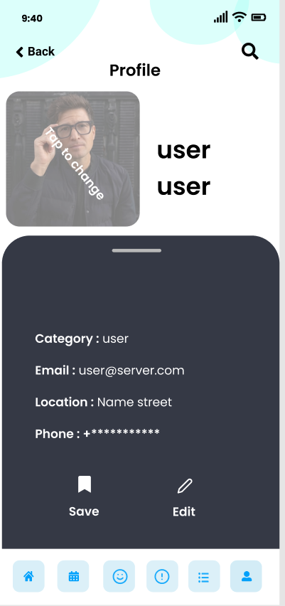
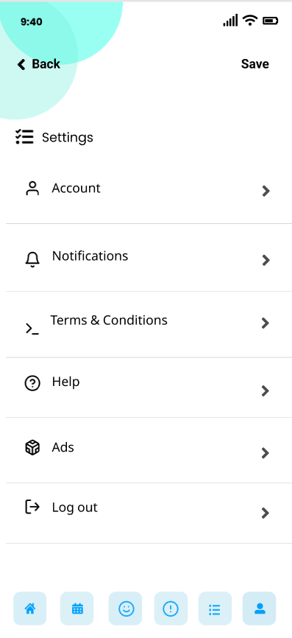
User interface
User My data
User Profile
User Settings

Slide 17
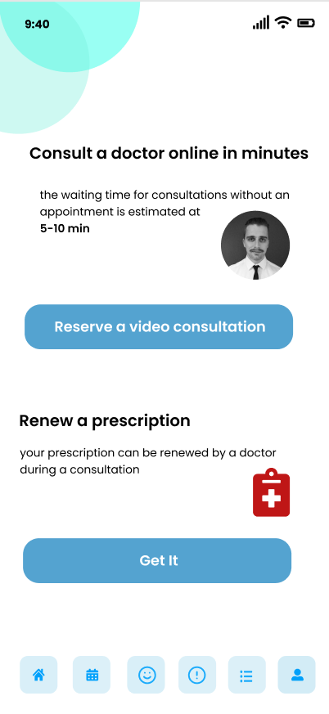
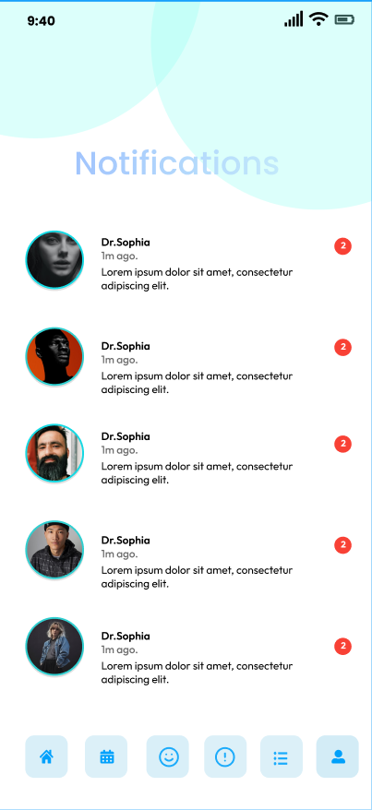
Consultation
Notifications

Slide 18
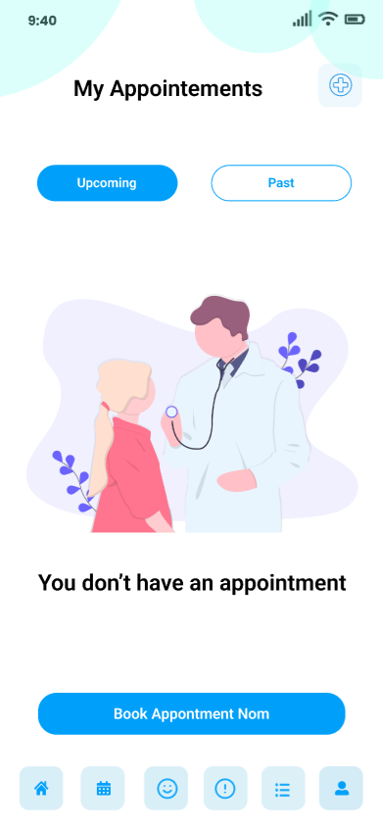
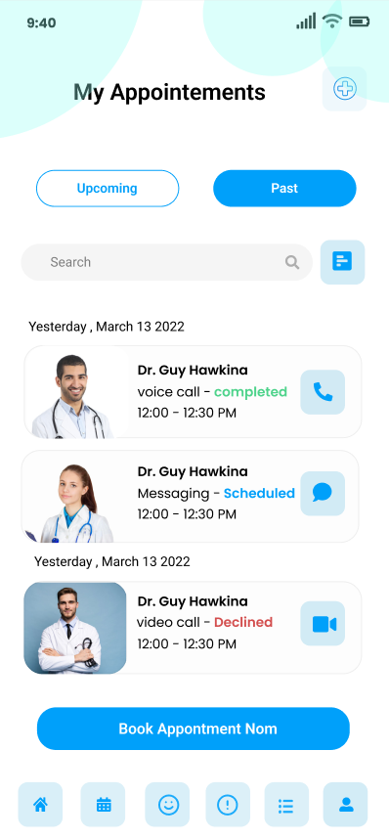
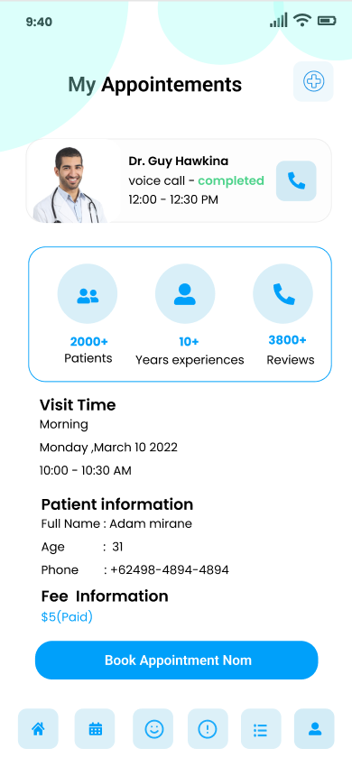
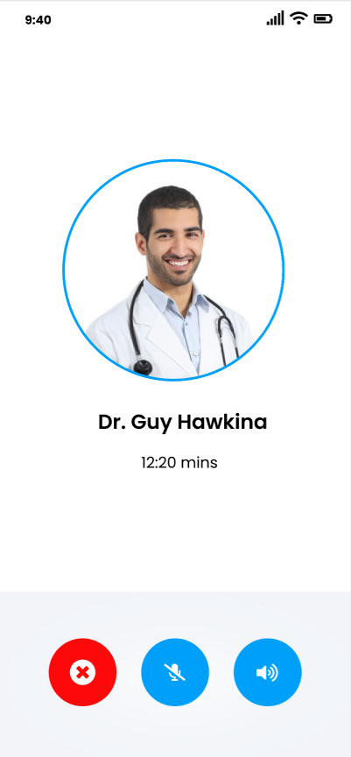
Appointement interfaces

Slide 19
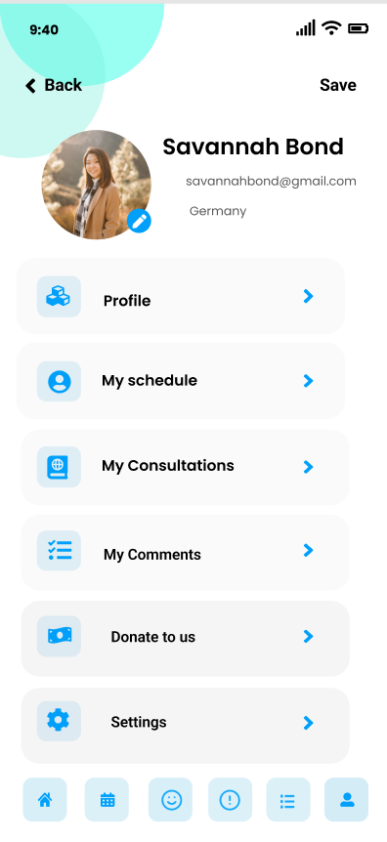
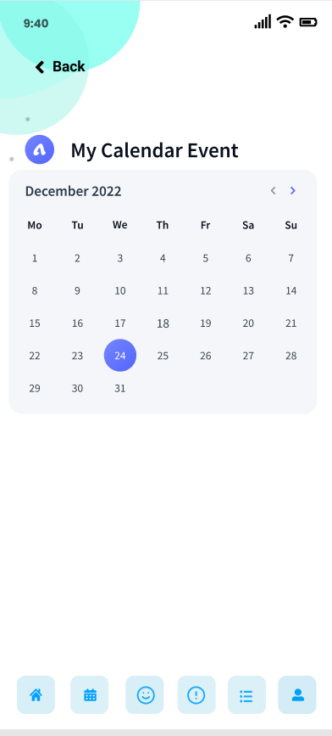
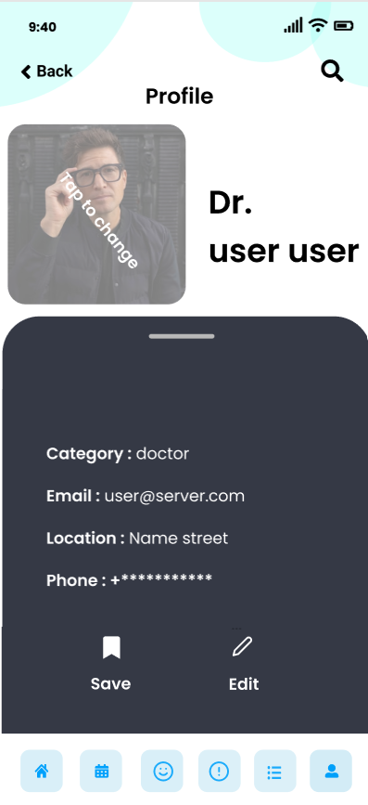
Doctor interface
Doctor My data
Doctor Profile

Slide 20
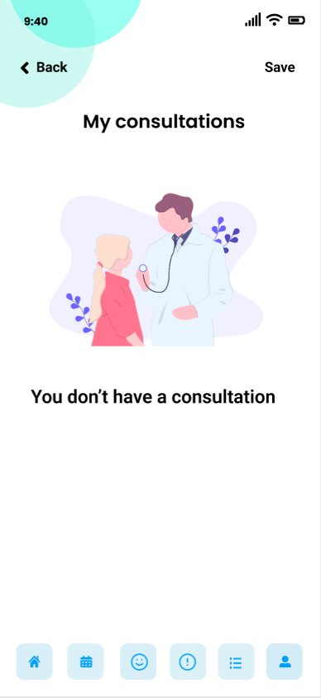
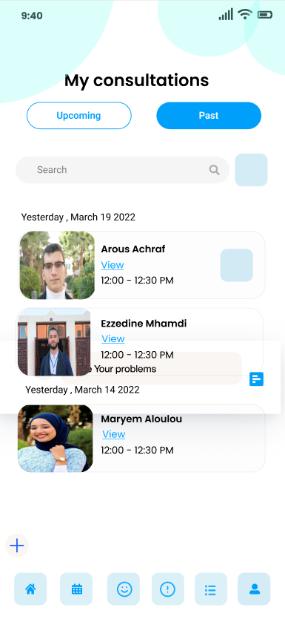
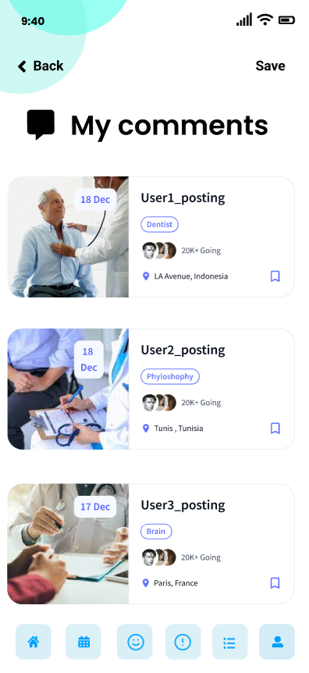
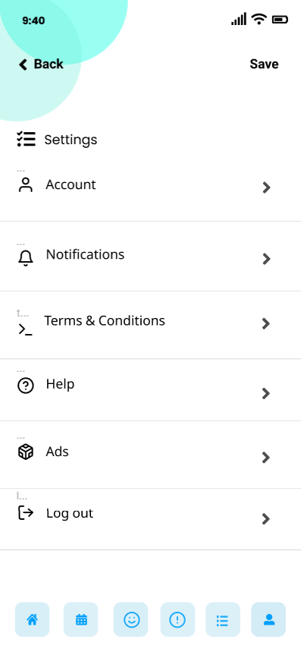
Consultations
Comments
Doctor Settings

Slide 21
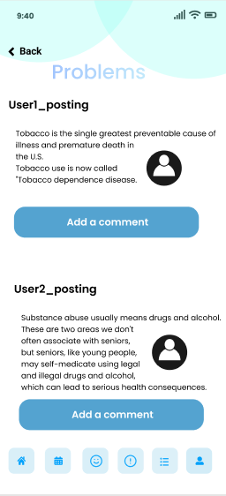
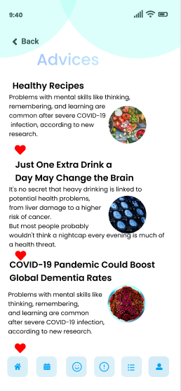
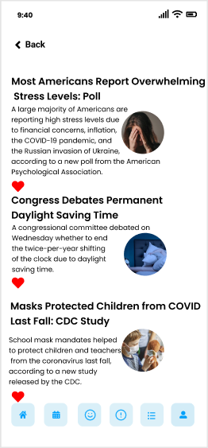
Problems
Advices

Slide 22
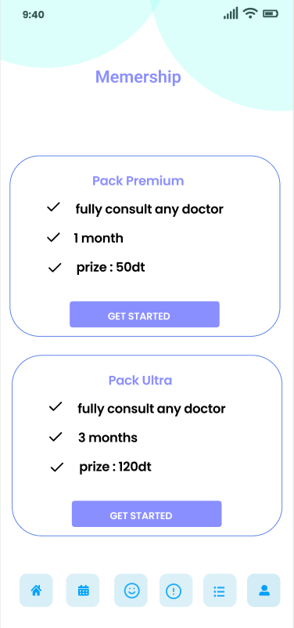
Memership
Our application isn't free so everyone need a memership to get consultations

Slide 23
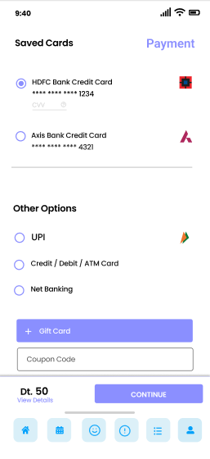
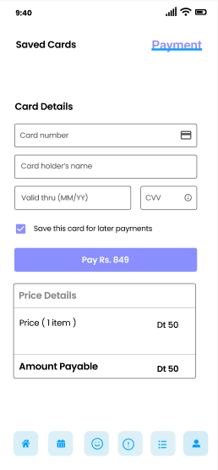
Payment

Slide 24
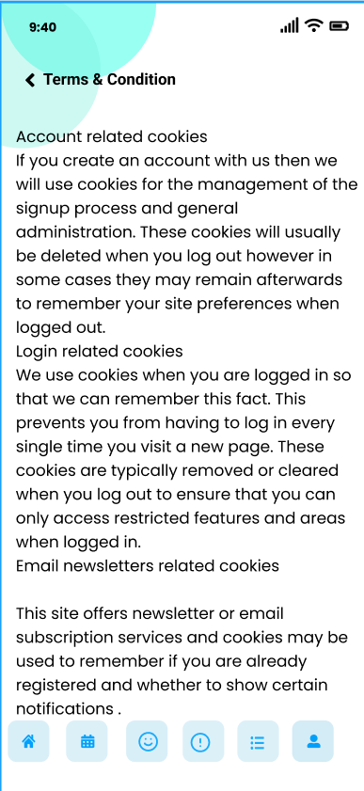
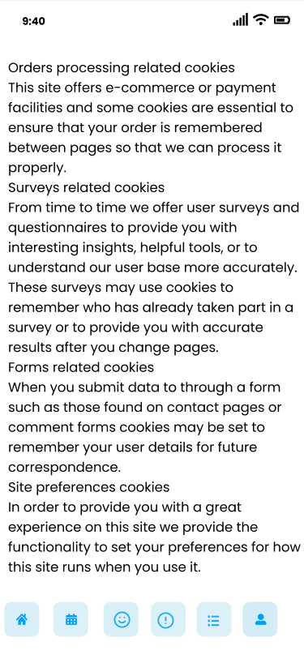
Terms & Condition

Slide 25
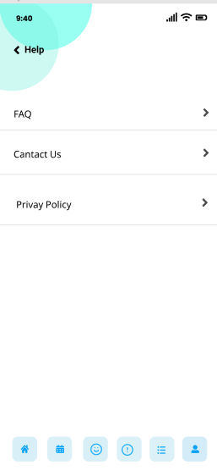
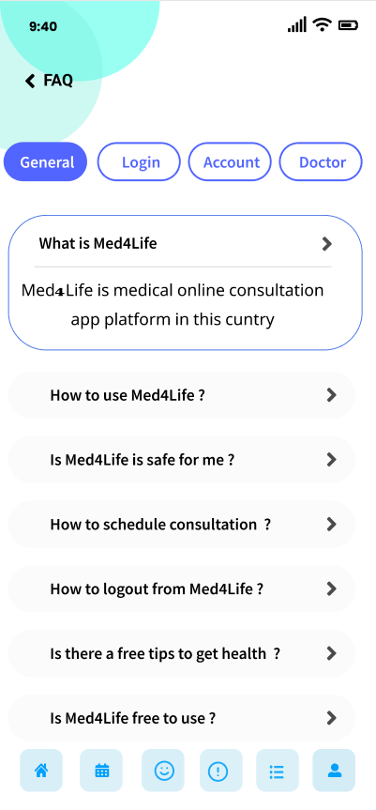
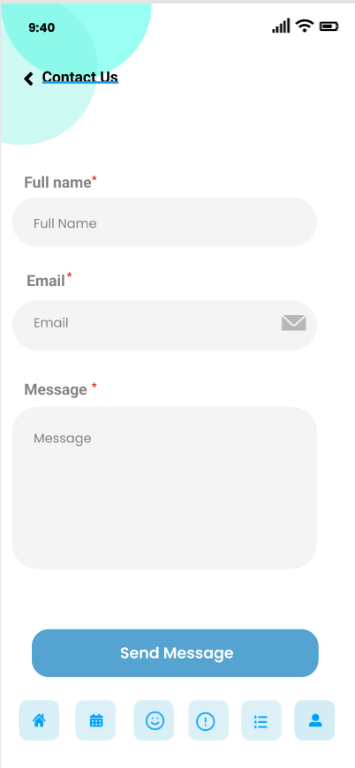
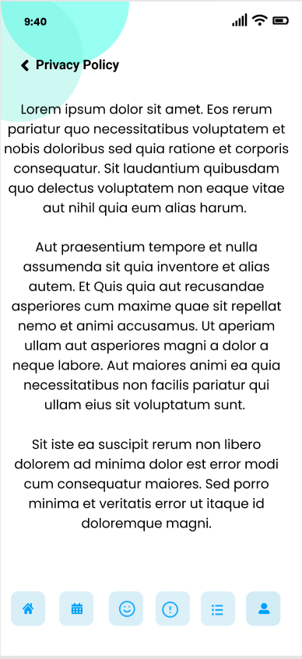
Help
FAQ
Contact us
Privacy Policy

Slide 26
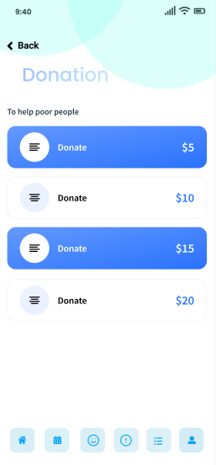
Donation
This the part when we gonna donate for the poor people in the world by collecting money's donation

Slide 27
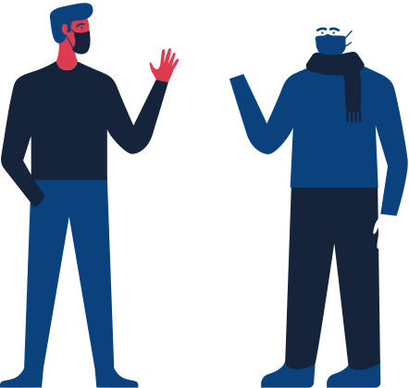
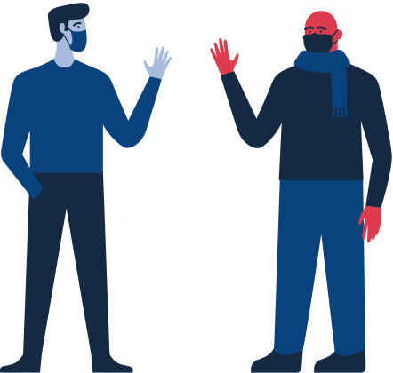
Part 05
About Us

Slide 28

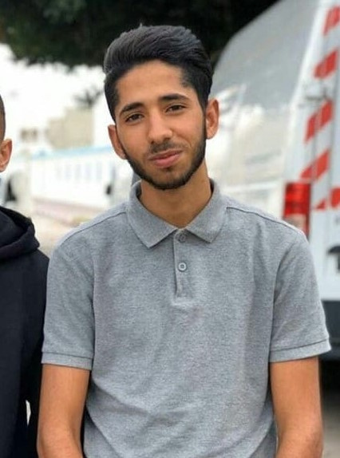
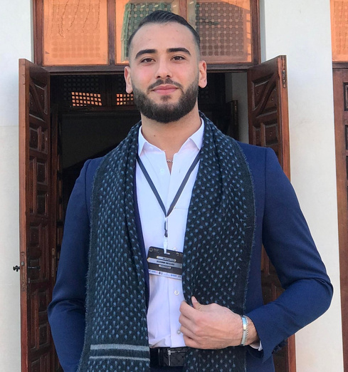
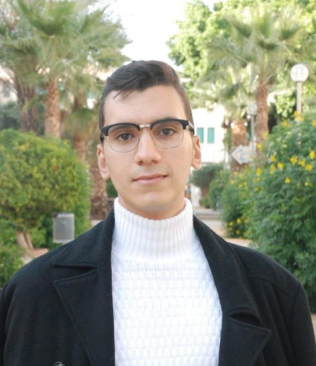
Our Team
Debug Entity
We born to develop
Fakhreddine Youssef
Ezzddine Mhamdi
Achraf Arous
Contact us : debugentityy@gmail.com

Slide 29

Thanks for your attention
Questions or comments?
Get in touch!

